Slide 1
Nov 2021
Energy Efficiency
Solar Tracking Technology
Autonomous Solar Tracking
Presentation made by:
Abayahia Hamou Zinedine
1

Slide 2
Introduction:
Providing sustainable, clean energy in an efficient manner.
Increasing the output power of a traditional photovoltaic system.
Dealing with some common issues which usually occur in solar tracking systems.
Highlighting new methods to reduce carbon footprint.
2

Slide 3
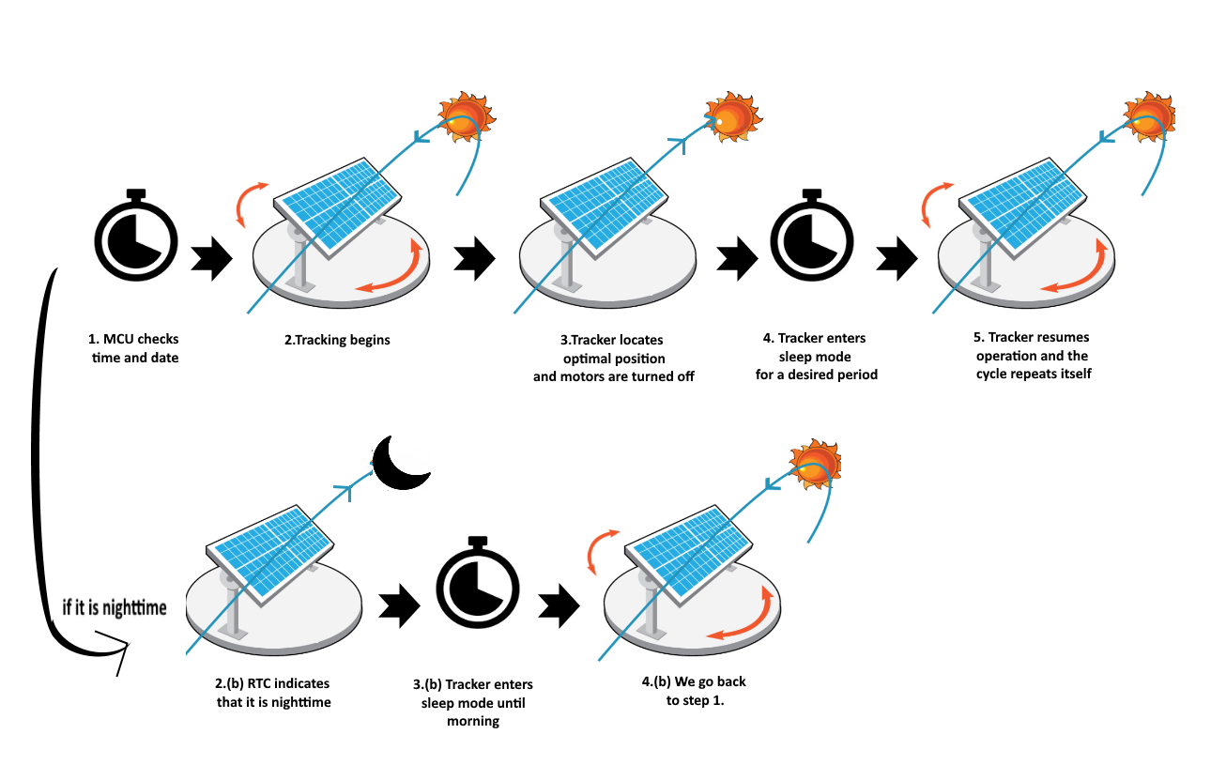
Working Concept:
3

Slide 4
Control Hardware Used for prototyping:
STM32 MCU.
Photoresistors for sensing. (LDR based sensing).
Switching MOSFETs
Actuation And Display Hardware Used:
Servo Motors.
LCD display with I²C module.
Safety And Power related Hardware:
Resistive current sensor.
DC-DC converter.
4

Slide 5
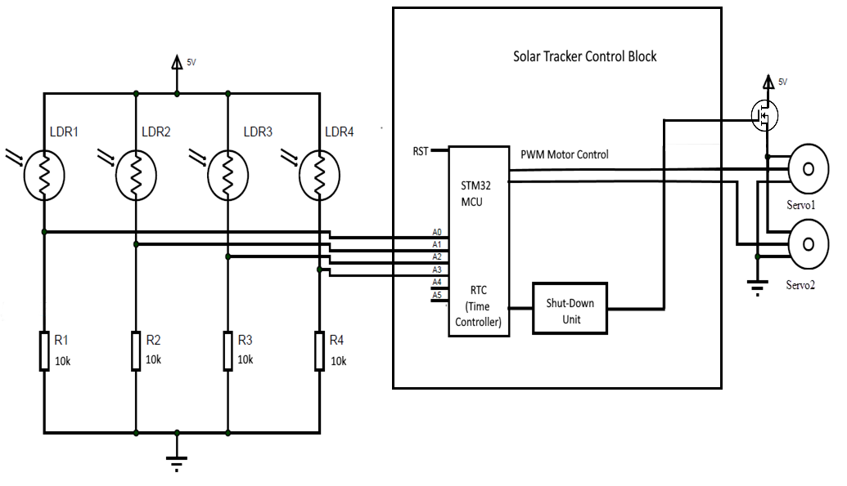
Schematic:
5V: DC-DC converter output
5

Slide 6
Completion stages:
Performing small-scale tests .
Planning and sizing.
Hardware design.
Implementation and execution.
Monitoring and reflection.
6

Slide 7
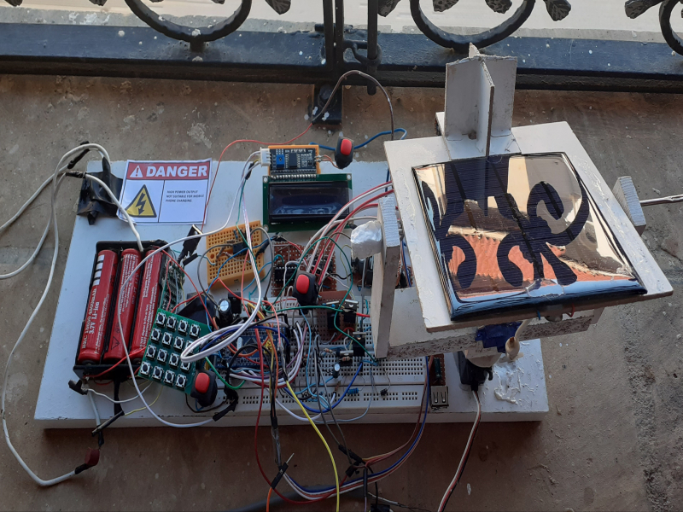
Initial Prototype :
7

Slide 8
End Goals:
Making an industrialized autonomous solar tracker.
Making solar energy more energy efficient and therefore more likely to be picked by corporations and civilians alike as their main energy source.
Having a positive effect on the environment by reducing greenhouse gases.
8

Slide 9
Template Source Link (mandatory citation): https://poweredtemplate.com/solar-power-panels-on-a-field-powerpoint-template-52648/

